Slide 1

Java LineNumberReader class
A buffered character-input stream that keeps track of line numbers. This class defines methods setLineNumber(int) and getLineNumber() for setting and getting the current line number respectively.
Line numbering begins at 0. Whenever the LineNumberReader encounters a line terminator in the characters returned by the wrapped Reader, the line number is incremented.
Line number can be handy if you are parsing a text file that can contain errors. When reporting the error to the user, it is easier to correct the error if your error message includes the line number where the error was encountered.
PrintStream
Reader(i.e FileReader)
LineNumberReader
Java Application
Read
Read

Slide 2
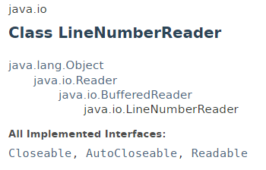
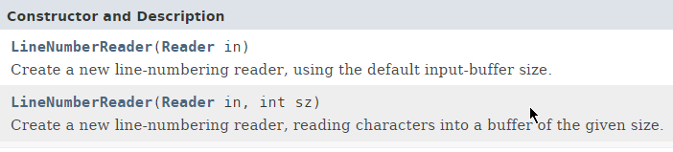
Java LineNumberReader class

Slide 3
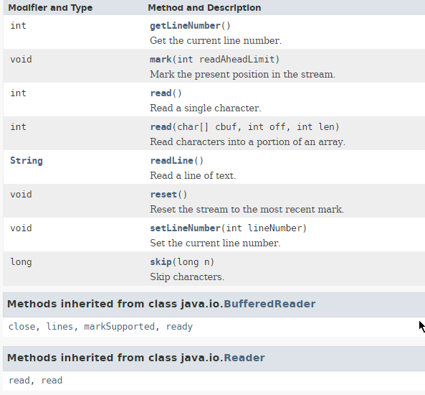
Java LineNumberReader class

Slide 4
Java LineNumberReader class
https://docs.oracle.com/javase/8/docs/api/index.html?java/io/LineNumberReader.html

